Slide 1
4Ws Problem Canvas
Who is having the problem?
1. Who are the stakeholders?
Web Development Department, Users Of the Movie Reviews Page.
2. What do you know about them?
Web Development Department: They are responsible for the website’s development, interested in the successful
implementation of the ‘Sentiment Analysis’ feature for promotional purposes.
Users Of the Movie Reviews Page: End users looking for an enriched and interactive experience, interested in movie sentiments
The Intel® AI For Youth Program was developed by Intel Corporation. Copyright © 2019 Intel Corporation. All rights reserved. Intel and the Intel logo are trademarks of Intel Corporation or its subsidiaries in the U.S. and/or other countries. *Other names and brands may be claimed as the property of others.

Slide 2
4Ws Problem Canvas
What is the nature of the problem?
1. What is the problem?
The absence of a 'Sentiment Analysis' feature on the movie reviews page.
2. How do you know it is a problem?
The request from the Web Development Department indicates a recognized need for enhancing the website's functionality.
The Intel® AI For Youth Program was developed by Intel Corporation. Copyright © 2019 Intel Corporation. All rights reserved. Intel and the Intel logo are trademarks of Intel Corporation or its subsidiaries in the U.S. and/or other countries. *Other names and brands may be claimed as the property of others.

Slide 3
4Ws Problem Canvas
Why do you believe it is a problem worth solving?
1. What would be of key value to the stakeholders?
Web Development Department: Enhanced website functionality, potentially attracting more users. Users of the Movie Reviews Page: Enriched and interactive movie reviews experience.
2. How would it improve their situation?
Web Development Department: Increased user interaction and satisfaction.
Users of the Movie Reviews Page: More informative and engaging movie reviews experience.
The Intel® AI For Youth Program was developed by Intel Corporation. Copyright © 2019 Intel Corporation. All rights reserved. Intel and the Intel logo are trademarks of Intel Corporation or its subsidiaries in the U.S. and/or other countries. *Other names and brands may be claimed as the property of others.

Slide 4
4Ws Problem Canvas
Where does the problem arise?
1. What is the context/situation in which the stakeholders experience the problem?
Web Development Department: Enhancing website functionality to meet market trends.
Users of the Movie Reviews Page: Desiring a more enriched and interactive experience when exploring movie reviews.
The Intel® AI For Youth Program was developed by Intel Corporation. Copyright © 2019 Intel Corporation. All rights reserved. Intel and the Intel logo are trademarks of Intel Corporation or its subsidiaries in the U.S. and/or other countries. *Other names and brands may be claimed as the property of others.

Slide 5
Data exploration

Slide 6
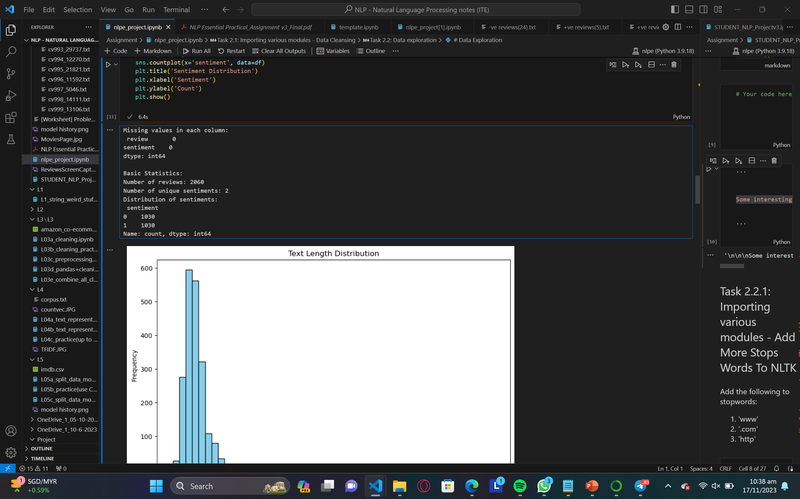
There are no missing values in either the 'review' or 'sentiment' columns, indicating a complete dataset.
Output of the data exploration
The dataset consists of 2060 reviews.
There are two unique sentiments (0 and 1), each with 1030 occurrences.
The sentiment distribution is balanced, with an equal number of reviews for both sentiments.

Slide 7
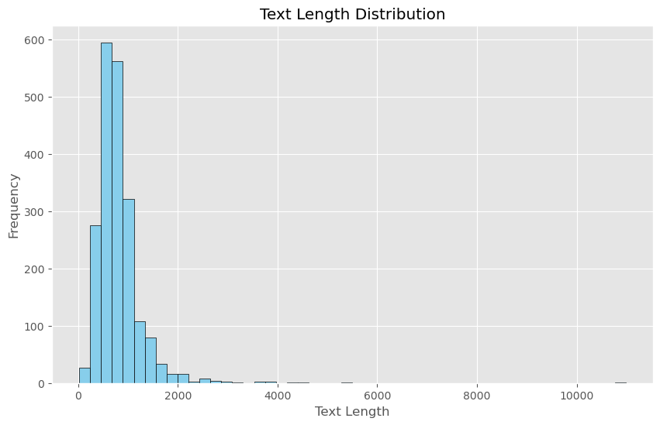
The graph you sent, titled "Text Length Distribution", shows the distribution of text length by frequency. This means that it shows how often texts of different lengths appear in a dataset.
The x-axis of the graph shows the text length in characters, while the y-axis shows the frequency of each text length. For example, the point at (100, 2000) on the graph means that there are 2000 texts in the dataset that are 100 characters long.
The graph shows that most texts in the dataset are between 200 and 600 characters long. There is a sharp decrease in frequency for texts longer than 600 characters, and very few texts are longer than 10000 characters.
This graph could be used for a variety of purposes, such as:
To identify the most common text lengths in a dataset
To analyze the distribution of text lengths in different genres of writing
To develop text processing algorithms that are tailored to the specific lengths of texts in a dataset

Slide 8
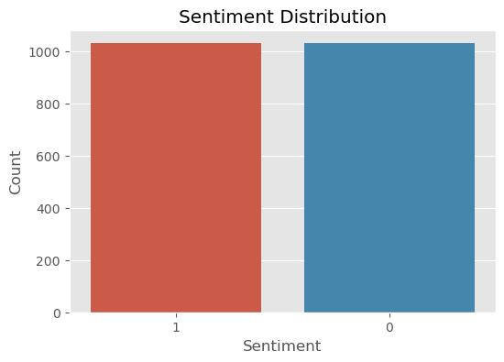
The sentiment distribution graph for a dataset of 2060 movie reviews. The graph shows that the sentiment distribution is balanced, with an equal number of reviews for both positive and negative sentiments (1030 reviews each). This means that the majority of people who wrote reviews for these movies had either a positive or negative opinion of them. This information can be used by the web development department to promote more popular movies. For example, they could create a list of the top 10 most positively reviewed movies of the week and display it prominently on the movie reviews page. This would encourage people to watch these movies, which are likely to be more popular with audiences. The sentiment distribution graph can also be used to identify trends in movie reviews. For example, the web development department could use the data to see which genres of movies are most popular with audiences. This information could then be used to promote more movies in those genres. Overall, the sentiment distribution graph is a valuable tool that can be used to improve the user experience on the movie reviews page and promote more popular movies.

Slide 9
Insight
The even distribution of sentiments suggests that the dataset is balanced and can potentially be suitable for training machine learning models without a class imbalance issue.
The wide variation in text lengths may pose a challenge for certain natural language processing (NLP) tasks. It could be beneficial to preprocess the data, such as by truncating or padding sequences, depending on the specific NLP model's requirements.
Further exploration into the content of reviews with extreme text lengths (very short or very long) could provide insights into potential outliers or specific patterns.

